Slide 1
Leveraging the attention mechanism to improve the identification of DNA N6-methyladenine sites

Slide 2
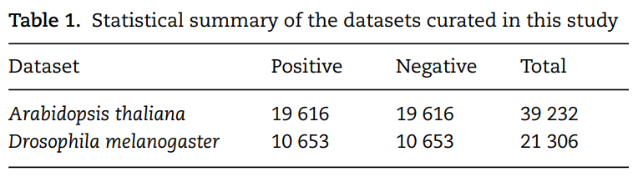
Benchmark datasets
In this study, the DNA 6mA data of the two model organisms Arabidopsis thaliana and Drosophila melanogaster were taken from [28] (DeepM6A). The raw data came from the PacBio public database [38]. Candidates were further filtered out by excluding those with the sequence variance located between 10 bp upstream and 5 bp downstream of the identified modification site and the variation ratio of the estimated methylation level of greater than 30%.
After this filtering procedure, 19 632 and 10 653 6mA sites for A. thaliana and D. melanogaster were obtained, respectively.

Slide 3
Benchmark datasets
Non6mA sites of the same number were used as negative samples. Each non-6mA site was at least 200 bp away from any neighboring 6mA site. For more detailed information on the data set construction, please refer to [28].
We further screened the sequences to weed out those sequences that contained sites with uncertain DNA bases. Finally, 19 616 positive samples and 10 653 positive samples were retained for A. thaliana and D. melanogaster, respectively. A statistical summary of the two datasets is provided in Table 1. For each organism, the samples were randomly divided with a ratio of 9:1 as the training and independent test datasets.

Slide 4
Feature representation
The proposed models take as the input a DNA sequence centered on 6mA site or non-6mA site. The binary one-hot encoding scheme is adopted to represent the input DNA sequences with the following rules: A = [1, 0, 0, 0], C = [0, 1, 0, 0], G = [0, 0, 1, 0] and T = [0, 0, 0, 1]. Such encoding scheme makes the elements in the encoding matrix correspond to the bases in the input sequence, which is convenient for the analysis of the attention matrix/vector. Accordingly, each DNA sequence of length L is converted to a 2D matrix of the size L × 4 after the encoding. The length of each sequence is 41 bp, which is composed of 20 flanking nucleotides at each side and the centered adenine site.

Slide 5
Network architecture
The input sequences are encoded and fed into the end-to-end networks directly. DNA data analysis is analogous to natural language processing [39], in which recurrent neural networks (RNNs) can be used to process the sequential data. As a popular and powerful RNN architecture, long short-term memory (LSTM) [40] has been widely used to address sequence analysis problems [41] and has achieved excellent performance. Here we employ BiLSTM to capture the short-range and long-range information of DNA sequences. The use of LSTM makes up the shortcoming for the lack of time information in the one-hot encoding.

Slide 6
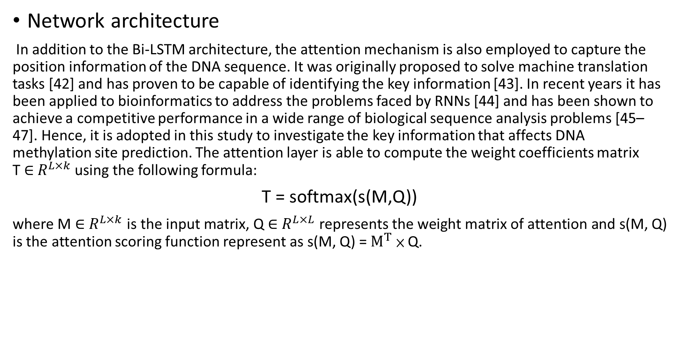
Network architecture
In addition to the Bi-LSTM architecture, the attention mechanism is also employed to capture the position information of the DNA sequence. It was originally proposed to solve machine translation tasks [42] and has proven to be capable of identifying the key information [43]. In recent years it has been applied to bioinformatics to address the problems faced by RNNs [44] and has been shown to achieve a competitive performance in a wide range of biological sequence analysis problems [45–47]. Hence, it is adopted in this study to investigate the key information that affects DNA methylation site prediction. The attention layer is able to compute the weight coefficients matrix T ∈ $R^{L×k}$using the following formula:
T = softmax(s(M,Q))
where M ∈ $R^{L×k}$is the input matrix, Q ∈ $R^{L×L}$ represents the weight matrix of attention and s(M, Q) is the attention scoring function represent as s(M, Q) = $M^{T}$ × Q.

Slide 7
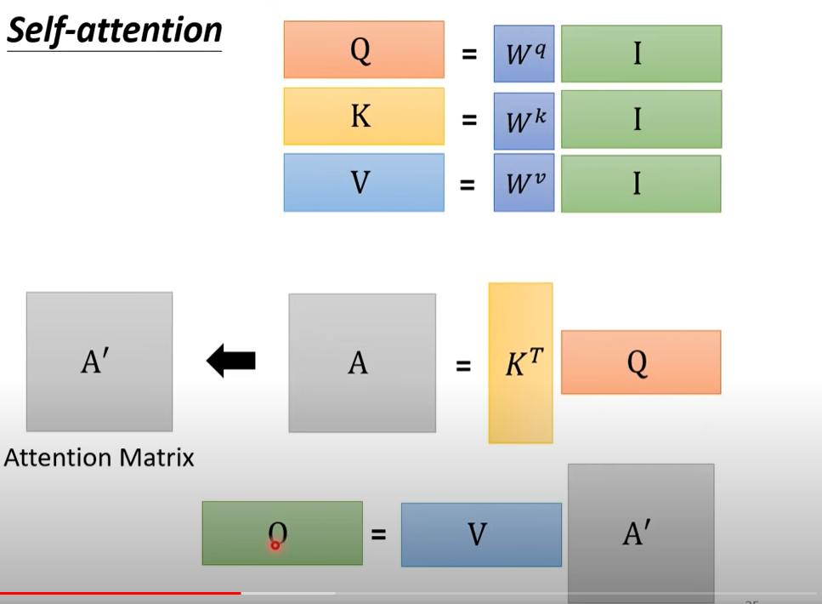

Slide 8
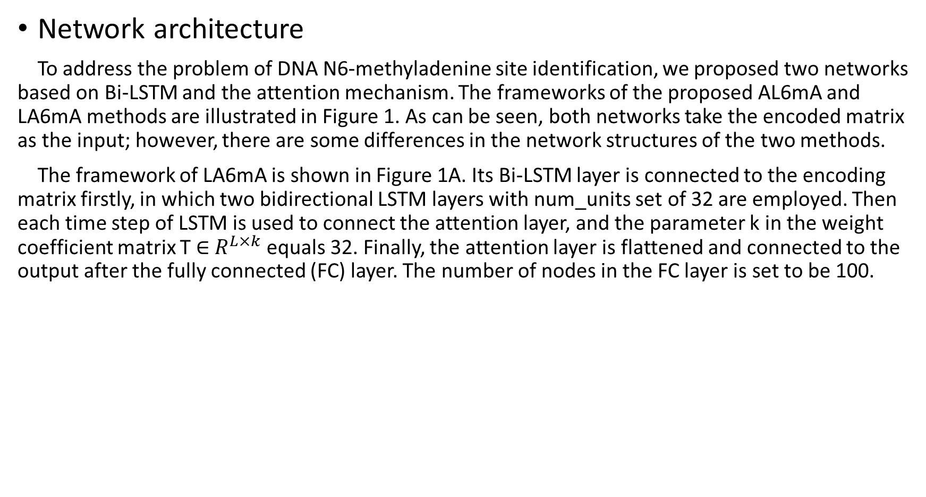
Network architecture
To address the problem of DNA N6-methyladenine site identification, we proposed two networks based on Bi-LSTM and the attention mechanism. The frameworks of the proposed AL6mA and LA6mA methods are illustrated in Figure 1. As can be seen, both networks take the encoded matrix as the input; however, there are some differences in the network structures of the two methods.
The framework of LA6mA is shown in Figure 1A. Its Bi-LSTM layer is connected to the encoding matrix firstly, in which two bidirectional LSTM layers with num_units set of 32 are employed. Then each time step of LSTM is used to connect the attention layer, and the parameter k in the weight coefficient matrix T ∈ $R^{L×k}$ equals 32. Finally, the attention layer is flattened and connected to the output after the fully connected (FC) layer. The number of nodes in the FC layer is set to be 100.

Slide 9
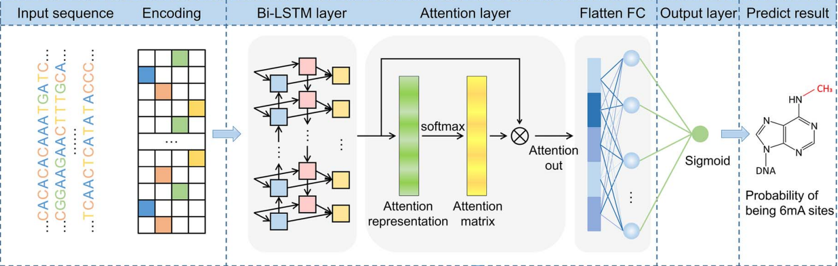
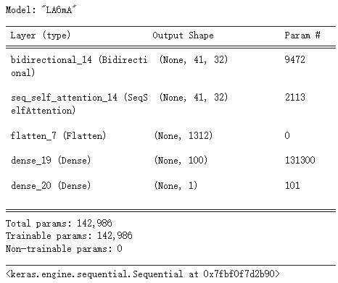
Network architecture

Slide 10
Network architecture
The structure of AL6mA is a little different from that of LA6mA, as shown in Figure 1D. The input sequence of length L is encoded and then directly connected with the attention layer. After the attention layer is one bidirectional LSTM layer, the parameters of which are as follows: num_units set is at 128, whereas the time_steps is set at 41. Finally, the output of the last time step of Bi-LSTM is used as the final predict result.

Slide 11
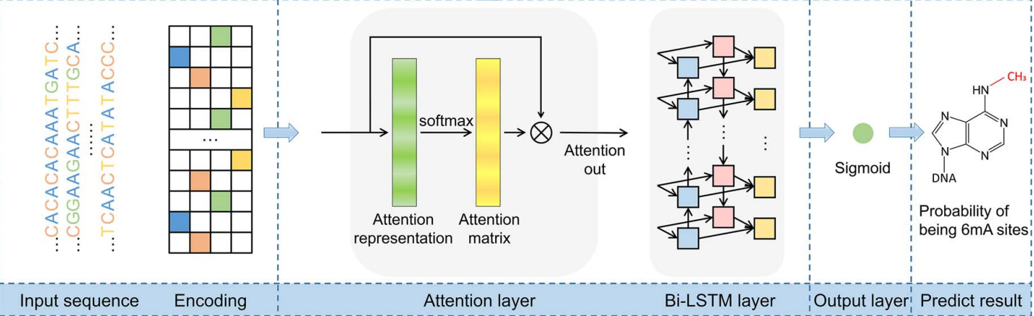
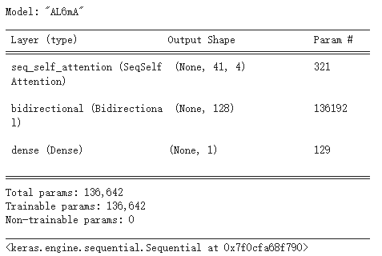
Network architecture

Slide 12
Network architecture
It is noteworthy that the two proposed methods are not merely used to predict potential methylation sites. They also enable us to perform an in-depth analysis of the hidden information that the model pays attention to and utilizes to make the prediction. Figure 1B and C depict how the attention matrices are analyzed and interpreted for this purpose.

Slide 13
Implementation
The models are implemented in Keras (version 2.3.1) and trained on one NVIDIA TITAN X GPU. The batch size is set to be 128. The Adam optimizer is employed with the default learning rate of 0.001, beta_1 = 0.9, beta_2 = 0.999, and a learning rate decay of 0.5 with patience of 7. 5-fold cross-validation is performed to determine the model structure and hyperparameters on the training data. After the model structure is determined, we take 8/9 (about 8/10 of the whole dataset) and 1/9 (about 1/10 of the whole dataset) of the training data to train and verify the trained model, respectively. Early stopping with patience of 7 is adopted on the validation set to avoid overfitting, which means the training process will terminate when the prediction performance does not improve on the validation set.
Opt:adam | Learning_rate=0.001 | beta_1 = 0.9 | beta_2 = 0.999
Learning rate decay=0.5 |  | Patience=7
Batch_size=128
Earlystopping | Monitor=val_loss | Patience=7

Slide 14
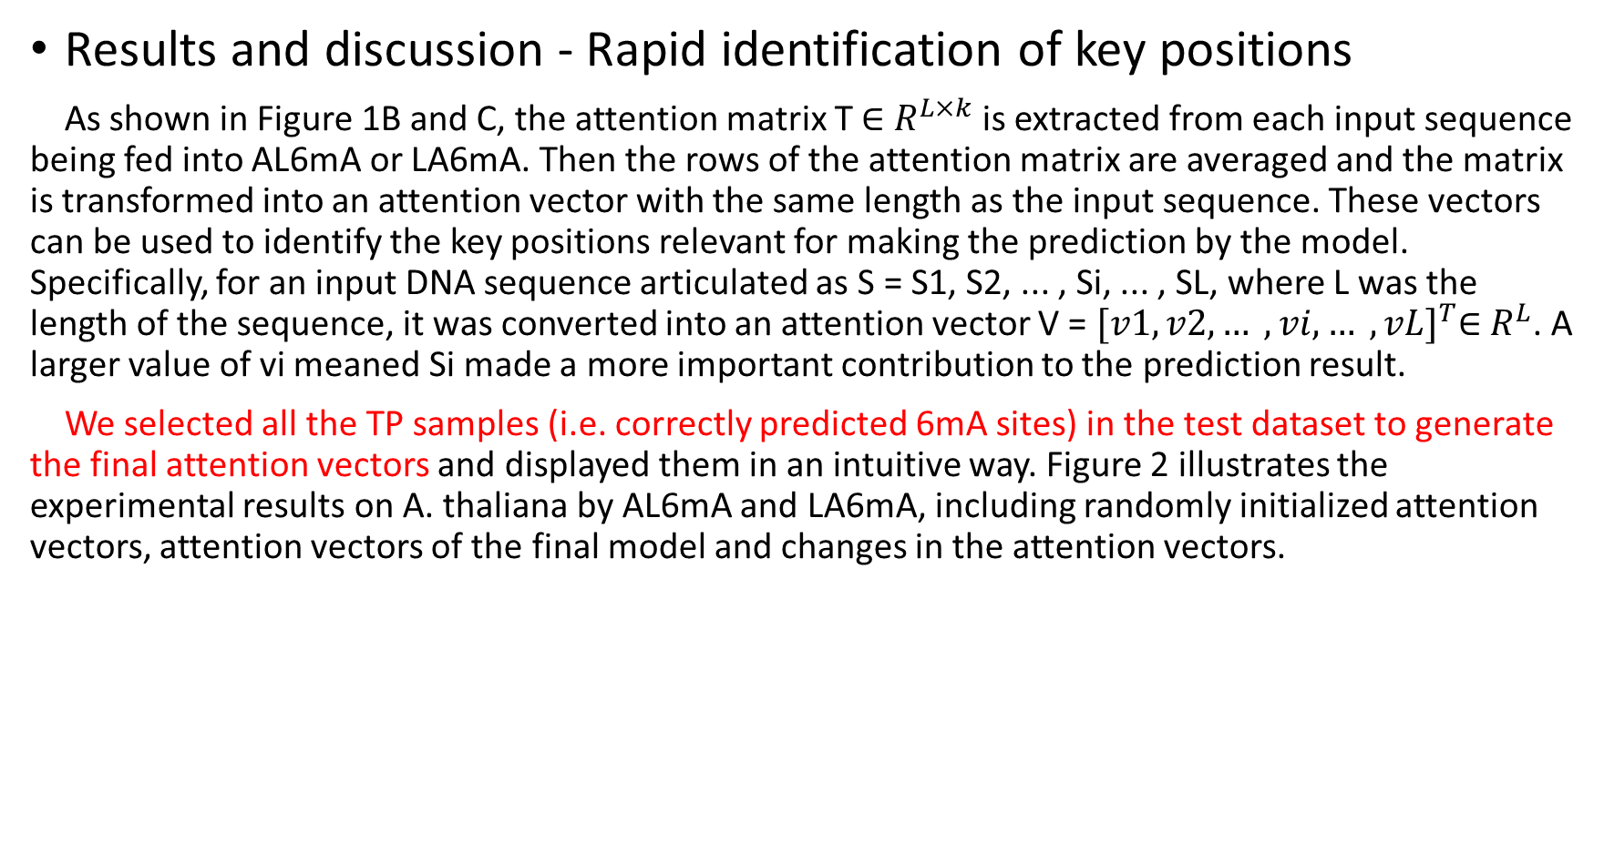
Results and discussion - Rapid identification of key positions
As shown in Figure 1B and C, the attention matrix T ∈ $R^{L×k}$ is extracted from each input sequence being fed into AL6mA or LA6mA. Then the rows of the attention matrix are averaged and the matrix is transformed into an attention vector with the same length as the input sequence. These vectors can be used to identify the key positions relevant for making the prediction by the model. Specifically, for an input DNA sequence articulated as S = S1, S2, ... , Si, ... , SL, where L was the length of the sequence, it was converted into an attention vector V = ${[v1, v2, … , vi, … , vL]}^{T}$∈ $R^{L}$. A larger value of vi meaned Si made a more important contribution to the prediction result.
We selected all the TP samples (i.e. correctly predicted 6mA sites) in the test dataset to generate the final attention vectors and displayed them in an intuitive way. Figure 2 illustrates the experimental results on A. thaliana by AL6mA and LA6mA, including randomly initialized attention vectors, attention vectors of the final model and changes in the attention vectors.

Slide 15
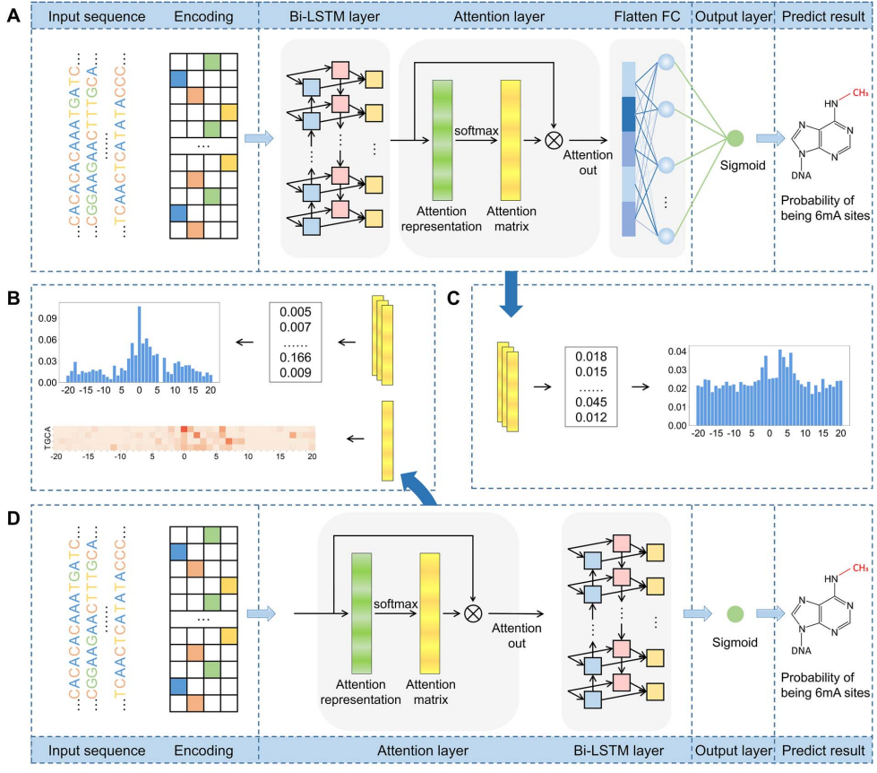

Slide 16
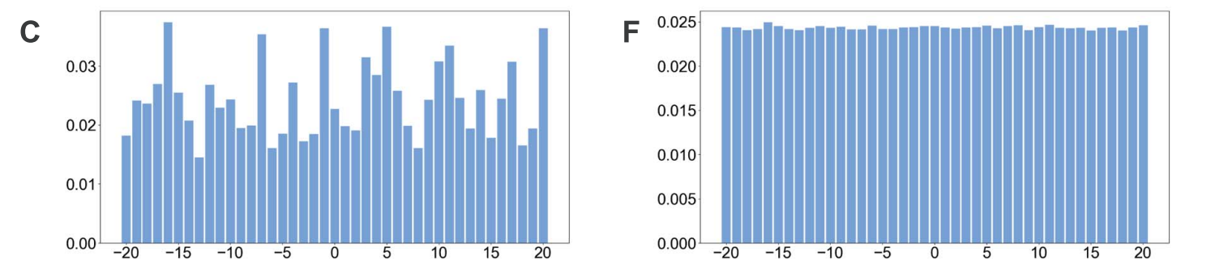
Results and discussion - Rapid identification of key positions
Figure 2C and F display the randomly initialized attention vectors of the AL6mA and LA6mA methods, respectively. As can be seen, the initial attention weights of AL6mA appeared to be distributed randomly throughout the sequence (Figure 2C), which obviously differed from each other.
In the case of LA6mA, its initialized attention weights were almost evenly distributed (Figure 2F). When an input sequence was fed into an initialized LA6mA model, the LSTM layer extracted the features of the sequence, which were then passed into the attention layer. That is the main reason why the values in the extracted initial attention vector of LA6mA were distributed evenly.

Slide 17
Results and discussion - Rapid identification of key positions
Figure 2A and D show the final attention vectors of AL6mA and LA6mA, respectively. Regardless of the distribution of the initial attention, it is apparent that the weights of the central region in the attention of the final model are larger than those of the marginal region. This suggests that the central region made more contributions to the prediction of the final result. Furthermore, we conjecture that the right flanking region contributed more to the prediction than the left f lanking region. Specifically, the region of [−2, 9] made the most significant contributions to the prediction in terms of the values of the attention weights. From a biological perspective, mutations in this region might affect the methylation possibility of the centered adenine site, which has been confirmed in [48]. In addition, the changes in methylation caused by such mutation may lead to abnormal biological processes.

Slide 18
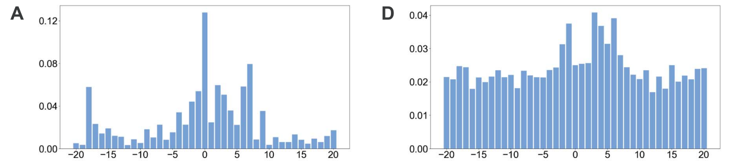
Results and discussion - Rapid identification of key positions

Slide 19
Results and discussion - Rapid identification of key positions
To observe the changes of the attention vectors, the attention weights were extracted during model optimization. The changes are then displayed as 3D graphics, shown in Figure 2B and E. It can be seen that, in accordance with the increase of the epochs, the values of the central regions increased, whereas the values of the marginal regions decreased, highlighting that the models could automatically focus on the key areas during the optimization. Surprisingly, the changes of the attention vectors that attended to the key positions appeared to occur after only a few epochs, and as the iteration progressed, the values of the attention vectors were being constantly fine-tuned and eventually reached the plateau. Figure 2B and E verified rapid identification of the key positions that are relevant for making the prediction by the model.

Slide 20
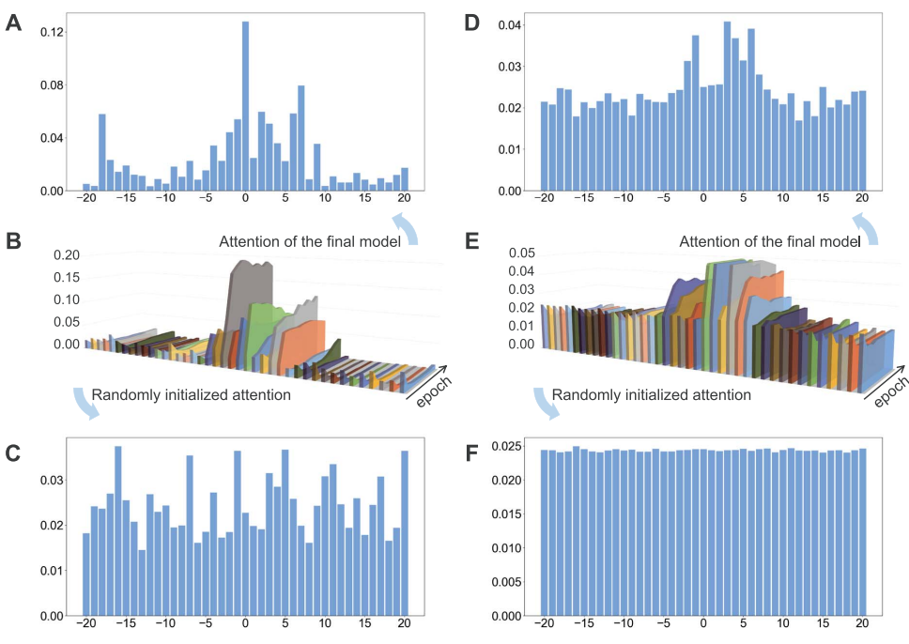

Slide 21
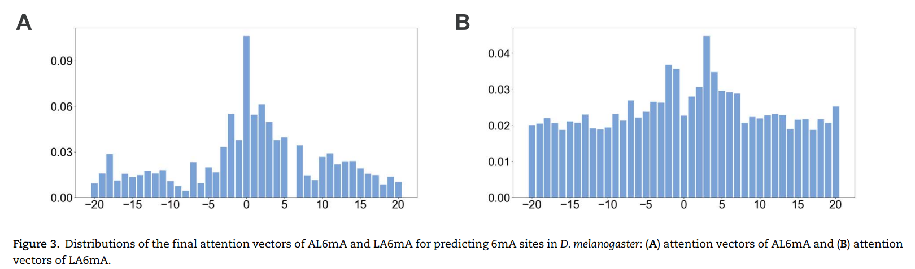
Similarities and differences of different attention layers
In this section, we performed a detailed analysis of the attention vectors on the two model organisms. The attention vectors of AL6mA and LA6mA on A. thaliana are displayed in Figure 2A and D. The final attention vectors of the well-trained AL6mA and LA6mA on D. melanogaster are displayed in Figure 3. We made the following important observations:
A. thaliana
AL6mA
A. thaliana
LA6mA
D. melanogaster AL6mA
D. melanogaster LA6mA
Notes:
在這節，他們對兩種生物的 attention vectors 進行了詳細分析。 圖 2A 和 D 顯示了阿拉伯芥上 AL6mA 和 LA6mA 的attention vectors 。圖 3 A,B 顯示了經過訓練的 AL6mA 和 LA6mA 在果蠅資料上的最終attention vectors 。他們總結了以下三個特點：

Slide 22
Similarities and differences of different attention layers - i
The right flanking region made more important contributions to the prediction than the left flanking region. In general, the values of the attention vectors within the region of [−2, 9] were comparably larger. It is also worth noting that LA6mA and AL6mA exhibited different characteristics with respect to the attention vectors. More specifically, the attention vectors calculated by the final LA6mA model of two model organisms seemed to be more similar (e.g. both values at the positions −2, −1, 3 and 4 were larger), whereas the attention vectors of the AL6mA model appeared to be significantly different (e.g. the values at the positions 0, 2, 6 and 7 were larger for A. thaliana, whereas the values at the positions −2, 0, 1, 2 and 3 were larger for D. melanogaster).
These results suggest that the attention mechanism could indeed attend to the key differential features and was good at identifying key areas of universality. In contrast, the attention layers connected to the original sequence tended to find the key positions of individuality.
Notes:
第一點:右側區域對預測的貢獻比左側區域更重要，[-2, 9] 區域內的 attention vectors 的值相對較大。LA6mA 和 AL6mA 的 attention vectors 表現出不同的特徵。兩個生物阿拉伯界和果蠅的最終 LA6mA 模型計算的attention vectors較相似（例如，-2、-1、3 和 4 位置的值都較大），而 AL6mA 模型的attention vectors 彼此明顯不同（例如，在位置 0、2、6 和 7 處的值對於阿拉伯界較大，而在位置 -2、0、1、2 和 3 處的值對於 D. melanogaster 較大）。 這些結果表明， attention vectors 確實可以關注關鍵的差異特徵，並且擅長識別關鍵領域。相比之下，與原始序列相連的attention layer傾向於找到個別的關鍵位置。

Slide 23
A. thaliana
AL6mA
A. thaliana
LA6mA
D. melanogaster AL6mA
D. melanogaster LA6mA
Notes:
第一點:右側區域對預測的貢獻比左側區域更重要，[-2, 9] 區域內的 attention vectors 的值相對較大。LA6mA 和 AL6mA 的 attention vectors 表現出不同的特徵。
兩種生物 阿拉伯界和果蠅最終的LA6mA 模型計算的attention vectors較相似（例如，-2、-1、3 和 4 位置的值都較大），
那 AL6mA 模型對兩種生物的attention vectors 明顯不同（例如，阿拉伯界在位置 0、2、6 和 7 處的值較大，而在D. melanogaster 位置 -2、0、1、2 和 3 處的值較大）。
這些結果表明，與 lstm相連的 attention vectors 擅長識別關鍵區域。相比之下，與原始序列相連的attention layer傾向於找到關鍵的 nucleotide。

Slide 24
Similarities and differences of different attention layers - ii
Although for both AL6mA and LA6mA, the attention weights of the central region were larger than those of the marginal region, they differed from each other in terms of the distribution of values. Taking Figure 3A and B as an example, the attention weight of the central region for the AL6mA method was considerably larger than that of the marginal region (approximately 7–12 times larger). In contrast, the weight difference for the LA6mA method was only 2.5–4 times larger. This result was not due to the different initialization values, but due to the use of different structures. For the LA6mA method, the attention layer was placed following the feature extraction layer and thus resulted in the attention distraction.
Notes:
儘管對於 AL6mA 和 LA6mA，中心區域的attention weights都大於邊緣區域的attention weights ，但它們在權重的分佈方面卻不同。 以圖 3A 和 B 為例，AL6mA (圖A)中心區域的attention weight 遠大於邊緣區域的 attention weight（大約大 7-12 倍）。 相比之下，LA6mA(圖B) 方法的 attention weight 中心與邊緣區域僅相差 2.5-4 倍。 這個是因為使用了不同的結構。 對於 LA6mA ，attention layer 被放置在特徵提取層之後，進而導致attention weight 分散。

Slide 25
Similarities and differences of different attention layers - iii
For the AL6mA method, there existed an abnormal region whose weight increased at the end of the right flanking region (i.e. the position −18, 19 and 20 for A. thaliana and the positions −18 for D. melanogaster, respectively). In addition, it can be observed that they gradually increased with increasing iterations, as shown in Figure 2B. A possible explanation is that only the output of the last time step of LSTM was used for making the prediction. Therefore, after continuing the iteration for some time, the attention weight of the right end would become larger. But fortunately, this change did not affect the pattern of the central key region.
Notes:
對於 AL6mA ，存在一個異常區域，其權重在末端會增加（即分別為阿拉伯芥的位置-18、19 和 20 和黑腹果蠅的位置-18）。 此外，可以觀察到它們隨著迭代次數的增加而逐漸增加，如圖 2B 所示。 一種可能的解釋是， LSTM 的最後一個time step 的輸出用於進行預測。 因此，在經過一段時間的跌代後，末端的attention weight 會變大。 但這個變化並未影響中間重點區域的pattern。

Slide 26
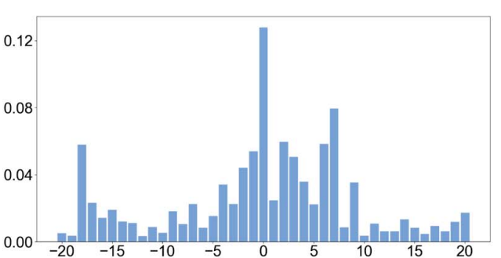
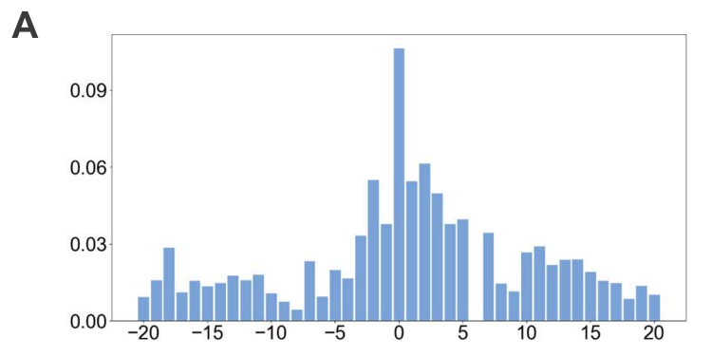
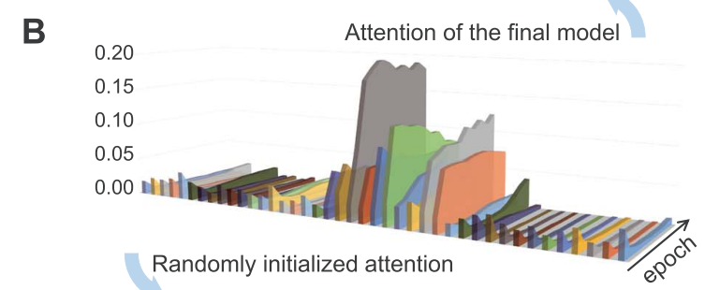
A. thaliana
AL6mA
D. melanogaster AL6mA
A. thaliana
AL6mA
Notes:
對於 AL6mA ，存在一個異常區域，其權重在末端會增加（即分別為阿拉伯芥的位置-18、19 和 20 和黑腹果蠅的位置-18）。 此外，可以觀察到位置-18、19 和 20 它們隨著迭代次數的增加最後逐漸遞增，如圖 2B 所示。 一種可能的解釋是，ˊ這個結構的輸出是用 LSTM 的最後一個time step 的輸出來進行預測。 因此，在經過一段時間的跌代後，末端的attention weight 會變大。 但這個變化並未影響中間重點區域的pattern。

Slide 27
Similarities and differences of different attention layers
In summary, the LA6mA method placed the attention layer after the feature extraction layer prior to being connected to an FC layer. Thus, the attention layer of the LA6mA model paid attention to the extracted features instead of the original sequence. To a certain extent, the attention may be distracted and become more abstract. On the other hand, the AL6mA model directly connected the attention layer to the input matrix, which paid attention to the underlying information and facilitated the discovery of the key position information.
Notes:
結論來說，因為LA6mA 將 attention layer 放在特徵提取層之後，然後再連接到 FC 層。
所以 LA6mA 模型的attention layers 關注的是提取的特徵而不是原始序列。
那在一定程度上，權重可能會分散，變得更加抽象。
而 AL6mA model 則是直接將 attention layers 連接 input matrix， 這有便於關鍵位置訊息的發現。

Slide 28
AL6mA revealed key nucleotides for 6mA prediction
As aforementioned, the attention vectors of LA6mA reveal key areas of universality, whereas AL6mA tends to find the key positions of individuality. The attention layer in AL6mA is directly connected to the encoding matrix, and the size is the same as that of the input 2D matrix. In this section, we further analyzed the detailed parameters in the attention layer of AL6mA.
To facilitate the analysis of the attention mechanism, we used pLogo [49] to generate the sequence logo representations for each position in the aligned groups of sequences. Specifically, the sequences surrounding the A bases at the center of A. thaliana and D. melanogaster were examined and motifs identified. The base heights were adjusted according to the statistical significance with P-value < 0.05. As shown in Figure 4, in both datasets, the enriched and depleted nucleotides in the DNA sequences surrounding the 6mA and non-6mA sites were significantly different.
Notes:
在這個 section 中，他們進一步分析了 AL6mA 的attention layer 中的參數。
為了便於分析attention ，他們使用 pLogo [49] 為對齊的序列中的每個位置生成 sequence logo 。 他們檢查了阿拉伯芥和果蠅中心的 A 周圍的序列並確定了關鍵的motif。 根據 P value < 0.05 的統計顯著性調整 base heights 。 如圖 4 所示，在兩個 dataset 中，6mA 和 non 6mA 位點周圍 DNA 序列中 enriched 和 depleted 的 nucleotide 存在顯著差異。

Slide 29
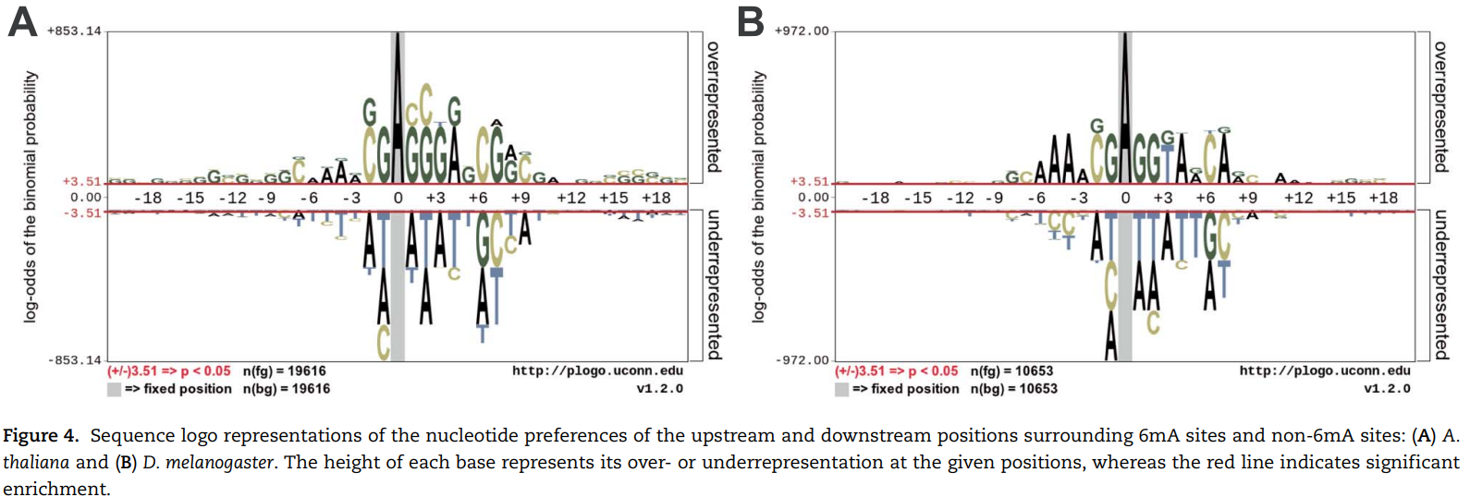
Notes:
在這個 section 中，他們進一步分析了 AL6mA 的attention layer 中的參數。
為了便於分析attention ，他們使用 pLogo [49] 為對齊的序列中的每個位置生成 sequence logo 。 他們檢查了阿拉伯芥和果蠅中心的 A 周圍的序列並確定了關鍵的motif。 根據 P value < 0.05 的統計顯著性調整 base heights 。 如圖 4 所示，在這兩個 dataset 中，6mA 和 non 6mA site 周圍 DNA 序列中 enriched 和 depleted 的 nucleotide 存在顯著的差異。

Slide 30
AL6mA revealed key nucleotides for 6mA prediction
For the well-trained model, an attention matrix with the size of L × 4 can be extracted from each input sequence. Different attention matrices were obtained from different sequence inputs, and the values in the attention matrix reflect which specific areas the model paid attention to when making the prediction. As shown in Figure 5A, the heatmap provides a visualization of the matrix, in which the values were highlighted by dark or light colors, with darker colors indicating larger values of the attention matrix, whereas lighter colors being the opposite.
Widespread short nucleotides of DNA sequences that are conjectured to have a functional role are defined as DNA sequence motifs [50]. In this context, except for the key area with a single sequence, we also analyzed the results based on a set of samples. Specifically, all the test samples were fed into the well-trained AL6mA model and accordingly all the attention matrices were extracted. Subsequently, the attention matrices of the TP and TN samples were picked out to calculate the mean value of the attention matrices. The mean attention matrix could be further mapped to a sequence to indicate the amount of information provided by different positions in the sequence. Figure 5B and C and Figure 6 show the results on A. thaliana and D. melanogaster, respectively. Taking the middle site in Figure 5B as an example, which referred to an adenine encoded with [1, 0, 0, 0], it shows that the 1st position (i.e. adenine) provides more important information than the other three positions.
Notes:
對於訓練好的模型，可以從每個輸入序列中獲得一個大小為 L×4 的attention matrix ， L=sequence length。從不同的 input 得到不同的 attention matrix，attention matrix中的值反映了模型在進行預測時關注了哪些特定的區域。
如圖 5A 所示，heatmap 較深的顏色表示attention matrix的值較大，而較淺的顏色則相反。
具有功能性的 DNA 核苷酸短序列被定義為 DNA sequence motif。除了分析單個序列的關鍵區域外，他們還對一組樣本的結果進行了分析。所有的測試樣本都被輸入到經過良好訓練的 AL6mA 模型中，因此所有的 attention matrix 都被提取出來。隨後，挑出 TP 和 TN 樣本的 attention matrix ，計算attention matrix 的平均值。平均 attention matrix 可以表示序列中不同位置提供的重要性。圖 5B 和 C 以及圖 6 分別顯示了阿拉伯芥和果蠅的結果。以圖 5B 中的中間為例，它表明第一個位置（A）比其他三個位置 (C, G, T ) 提供了更重要的訊息。

Slide 31
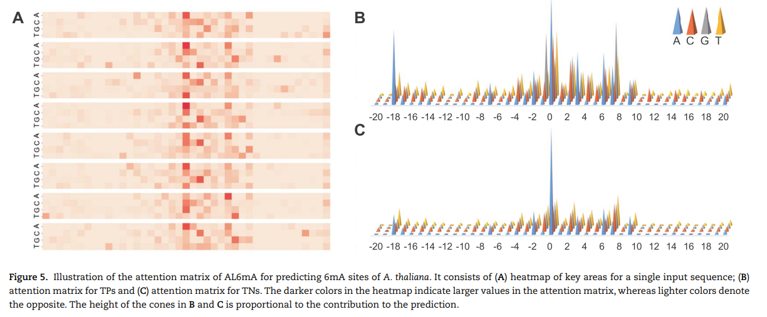
Notes:
對於訓練好的模型，可以從每個輸入序列中獲得一個大小為 L×4 的attention matrix ， L=sequence length。從不同的 input 得到不同的 attention matrix，attention matrix中的值反映了模型在進行預測時關注了哪些特定區域。
如圖 5A 所示，heatmap 較深的顏色表示attention matrix的值較大，而較淺的則相反。
除了分析單個序列的關鍵區域外，他們還對一組樣本的結果進行了分析。所有的 test sample 都被輸入到經過良好訓練的 AL6mA 模型中，因此所有的 attention matrix 都被提取出來。隨後，挑出 TP 和 TN 樣本的 attention matrix ，計算attention matrix 的平均值。平均 attention matrix 可以表示序列中不同位置提供的重要性。圖 5B 和 C 以及圖 6 分別顯示了阿拉伯芥和果蠅的結果， 5b的是 TP 的 attention matrix ， 5C 是 TN 的 attention matrix 。圖六則是果蠅的 attention matrix ， 以圖 5B 中的中間為例，它表明第一個位置（A）比其他三個位置 (C, G, T ) 提供了更重要的訊息。

Slide 32
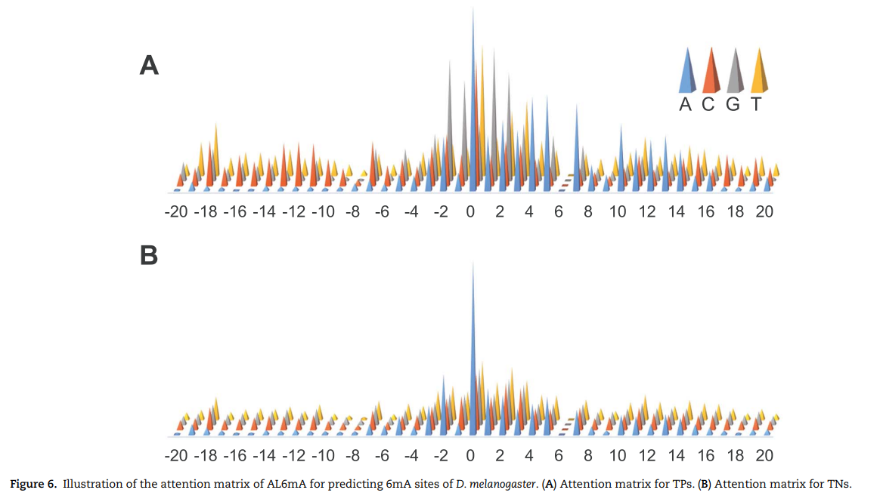
Notes:
對於訓練好的模型，可以從每個輸入序列中獲得一個大小為 L×4 的attention matrix ， L=sequence length。從不同的 input 得到不同的 attention matrix，attention matrix中的值反映了模型在進行預測時關注了哪些特定區域。
如圖 5A 所示，heatmap 較深的顏色表示attention matrix的值較大，而較淺的則相反。
除了分析單個序列的關鍵區域外，他們還對一組樣本的結果進行了分析。所有的 test sample 都被輸入到經過良好訓練的 AL6mA 模型中，因此所有的 attention matrix 都被提取出來。隨後，挑出 TP 和 TN 樣本的 attention matrix ，計算attention matrix 的平均值。平均 attention matrix 可以表示序列中不同位置提供的重要性。圖 5B 和 C 以及圖 6 分別顯示了阿拉伯芥和果蠅的結果， 5b的是 TP 的 attention matrix ， 5C 是 TN 的 attention matrix 。圖六則是果蠅的 attention matrix ， 以圖 5B 中的中間為例，它表明第一個位置（A）比其他三個位置 (C, G, T ) 提供了更重要的訊息。

Slide 33
AL6mA revealed key nucleotides for 6mA prediction
We further revealed key nucleotides for 6mA prediction in lieu of the importance of each location in the key area through the analyses of the attention matrices of the TP examples and TN examples. With reference to the attention matrix in Figure 5B and C and Figure 6, we list the key nucleotides that collectively contributed to the correct prediction. The key nucleotides for A. thaliana and D. melanogaster are listed in Tables 2 and 3, respectively. We consider the number of statistically significant bases. Taking the position 1 in the Sequence logo of positive samples in Figure 4A as an example, both nucleotides C and G were found to be statistically significant. Thus, the two nucleotides with the highest height at the position 1 in Figure 5B are listed in the Table.
Comparing the key nucleotides with the result of statistical significance one by one, we can find that for the TP samples, only several key nucleotides weight share consistent patterns with nucleotide sequence logos, whereas most key nucleotides are different from the nucleotide sequence logos. Specifically, for the TP samples of A. thaliana, only the positions −1, 1, 2 and 7 share the same pattern with the sequence logos (G, C/G G/C, G respectively). And for the TP samples of D. melanogaster, only the positions −1, 1, 2, 4, 7 shared the same motifs (G, G, G, A, A/G). In contrast, for the TN samples of the two model organisms, the nucleotides with the high attention weight are almost identical to the sequence logos.
Notes:
通過對 True Positive 和 True Negative 的 attention matrix 的分析，他們進一步發現了6mA 預測的關鍵 nucleotide。參考圖 5B 和 C 以及圖 6 中的 attention matrix ，他們列出了共同促成正確預測的關鍵 nucleotide 。 阿拉伯芥和果蠅的關鍵nucleotide 分別列於表 2 和表 3 中。他們考慮統計上顯著的鹼基的數量。以圖 4A 中陽性樣本的 Sequence logo 中的位置 1 為例，發現nucleotide C 和 G 均具有統計學意義。因此，表中列出了剛剛圖 5B 中位置 1 處高度最高的兩個nucleotide。 將關鍵 nucleotide 與統計顯著性結果的 nucleotide一一比較，我們可以發現，對於TP樣本，只有幾個關鍵 nucleotide 的權重與 nucleotide 序列標識一致，而大多數關鍵 nucleotide 與序列分析標識不同。具體而言，對於阿拉伯芥的 TP 樣本，只有位置 -1、1、2 和 7 與序列標識（分別為 G、C/G G/C、G）共享相同的模式。對於果蠅的 TP 樣本，只有位置 -1、1、2、4、7 共享相同的基序（G、G、G、A、A/G）。相比之下，對於兩種生物的 TN 樣本，具有高注意力權重的 nucleotide 幾乎與序列分析標識相同。

Slide 34
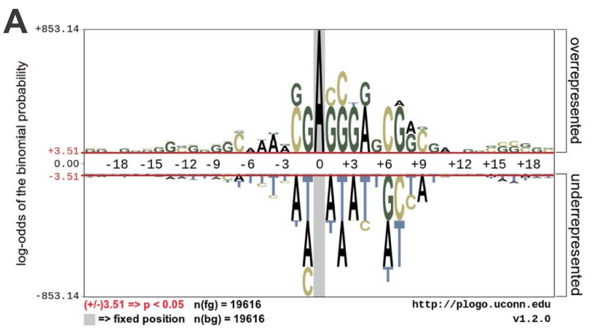
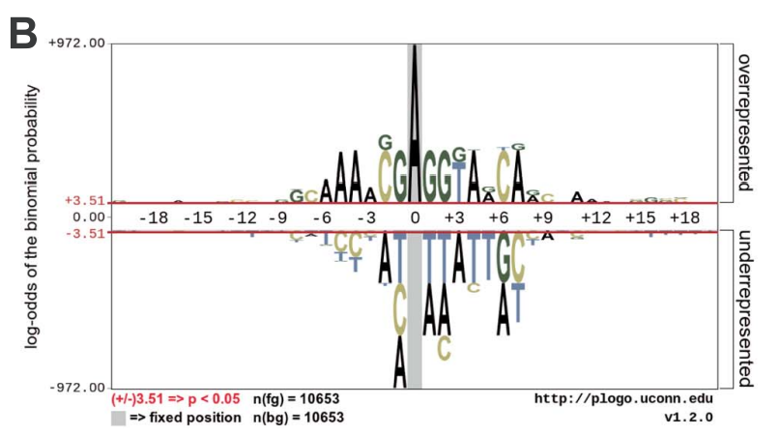
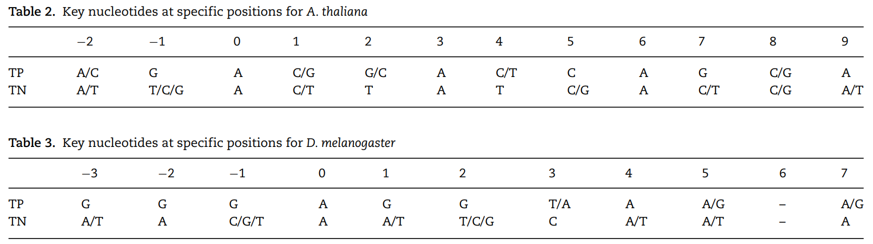
A. thaliana
D. melanogaster
Notes:
通過對 True Positive 和 True Negative 的 attention matrix 的分析，他們進一步發現了6mA 預測的關鍵 nucleotide。參考圖 5B 和 C 以及圖 6 中的 attention matrix ，他們列出了共同促成正確預測的關鍵 nucleotide 。 阿拉伯芥和果蠅的關鍵nucleotide 分別列於表 2 和表 3 中。他們考慮統計上顯著的鹼基的數量。以圖 4A 中陽性樣本的 Sequence logo 中的位置 1 為例，發現nucleotide C 和 G 均具有統計學意義。因此，表中列出了對應 attention matrix 中位置 1 處高度最高的兩個nucleotide。 將關鍵 nucleotide 與統計顯著性結果的 nucleotide一一比較，可以發現，對於TP樣本，只有幾個關鍵 nucleotide 的權重與 nucleotide Sequence logo 一致，而大多數關鍵 nucleotide 與序列分析標識不同。對於阿拉伯芥的 TP 樣本，只有位置 -1、1、2 和 7 與序列分析（分別為 G、C/G、G/C、G）相同。對於果蠅的 TP 樣本，只有位置 -1、1、2、4、7 共享相同的 nucleotide （G、G、G、A、A/G）。相比之下，對於兩種生物的 TN 樣本，具有高 attention weight 的 nucleotide 幾乎與 Sequence logo 相同。

Slide 35
AL6mA revealed key nucleotides for 6mA prediction
This is an interesting phenomenon. The correct prediction of negative samples is largely attributed to the attention to enriched nucleotides. For the type of binary classification problem, the number of negative samples is huge. The experiment randomly selects samples with the same number of positive samples as negative samples. If the algorithm needs to identify negative samples correctly, it should pay attention to the distribution of nucleotides. The correct prediction mechanism of the positive sample is different. The key nucleotides are not the same as significant distribution. It automatically pays more attention to the C site and G site.
Notes:
這表示負樣本的正確預測很大程度上歸功於對 enriched nucleotide 的關注。
對於二分類問題，負樣本的數量很龐大。
他們這個實驗隨機選擇與正樣本相同的負樣本。 如果演算法需要正確識別負樣本，那應該要注意 nucleotide 的分佈。
正樣本的正確預測機制不同。 關鍵 nucleotide 與 sequence logo 顯著 分佈不同。 Model 更加關注 C 和 G site

Slide 36
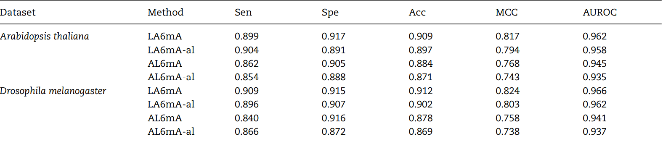
Impact of the attention layer on the model performance
In this section, we investigated the potential impact of the attention layer on the model performance. Specifically, we removed the attention layers of LA6mA and AL6mA, respectively, and compared the performance of these methods. For convenience, the attention-layer-removed LA6mA is named as LA6mA-al, and the attention-layer-removed AL6mA is named as AL6mA-al. The performance results on the test datasets are shown in Table 4. It can be seen that nearly all the performance measures of the models without the attention layer decreased, compared with those of the corresponding models with the attention layer. Of the five performance measures in Table 4, AUROC can be regarded as a comprehensive prediction performance measure as it does not rely on the prediction cutoff threshold.
Notes:
在本節中，他研究了 attention layer 對模型性能的影響。
他們分別去除了 LA6mA 和 AL6mA 的 attention layer，並比較了這些方法的性能。
為方便起見，去除 attention layer 的 LA6mA 命名為 LA6mA-al，去除 attention layer 的 AL6mA 命名為 AL6mA-al。
測試數據集上的性能結果如表 4 所示。可以看出，與具有 attention layer 的模型相比，幾乎所有沒有 attention layer 的模型的性能都有所下降。

Slide 37
Impact of the attention layer on the model performance
LA6mA-al and AL6mA-al achieved an AUROC of 0.958 and 0.935 on A. thaliana, which were 0.004 and 0.01 lower than that of LA6mA and AL6mA, respectively. On the dataset of D. melanogaster, LA6mA-al and AL6mA-al achieved an AUROC of 0.962 and 0.937, which were decreased by 0.004 and 0.004, compared with that of LA6mA and AL6mA, respectively. On the other hand, the results highlight effectiveness of the attention layer on the performance of the two proposed methods. It can be seen from Table 4 that LA6mA performed better than AL6mA with an improvement of 0.017 and 0.025 in terms of AUROC on A. thaliana and D. melanogaster, respectively. The performance difference is due to by their different structures (Figure 1A and D). In addition, it is worth mentioning that with the attention layer removed, LA6mA-al still performed better than AL6mA. This is because LA6mA used the FC layers, but AL6mA did not.
Notes:
LA6mA-al 和 AL6mA-al 在阿拉伯芥上的 AUC 分別為 0.958 和 0.935，分別沒有去除 attention layer 低 0.004 和 0.01。 在果蠅dataset上，去除 attention layer 的兩個 model 的 AUC 分別為 0.962 和 0.937，沒有去除 attention layer 的兩個 model 相比分別都下降了 0.004。
結果突顯了 attention layer 對兩種方法性能的差異。
從表 4 可以看出，LA6mA 在 阿拉伯界 和 果蠅 上的 AUC 都優於 AL6mA，分別提高了 0.017 和 0.025。 性能差異是由於它們的結構不同（圖 1A 和 D）。 另外值得一提的是，去掉attention layer 後，LA6mA-al的表現依然優於AL6mA。 這是因為 LA6mA 使用了 FC 層，而 AL6mA 卻沒有。

Slide 38
Performance of the proposed models on 5-fold cross-validation
We evaluated the performance of the proposed models on the training datasets on 5-fold cross-validation. To do so, we randomly divided the training datasets into five nonoverlapping subsets. In each validation step, four subsets were used to train the model, whereas the remaining subset was used to test the performance of the trained model. The unweighted averages of the 5-fold cross-validation were calculated as the final results. To make a fair comparison, the division of the subsets was fixed for the methods on the same model organisms. The average performance results, along with the SD, are provided in Table 5. It can be seen that LA6mA achieved the best performance. The AUROC value was 0.960 and its SD was 0.002 on A. thaliana, whereas the AUROC value was 0.963 and its SD was 0.003 on D. melanogaster, respectively. The performance of AL6mA was slightly lower than that of LA6mA. The SD of the performance measures of LA6mA ranged from 0.002 to 0.016, whereas those of AL6mA ranged from 0.003 to 0.018, which reflects the robustness of the proposed models on the 5-fold cross-validation.
Notes:
他們通過 5-fold cross-validation 評估了所提出模型在 training dataset 上的性能。
為了進行公平比較，對於相同生物，five-fold 的 5 個 folds 都是固定的。表 5 提供了平均性能結果與標準差。可以看出 LA6mA 性能最好。阿拉伯芥的 AUC 為 0.960，其 SD 為 0.002，而果蠅的 AUC 值為 0.963，其 SD 為 0.003。 AL6mA 的性能略低於 LA6mA。 LA6mA 性能測量的 SD 範圍從 0.002 到 0.016，而 AL6mA 的 SD 範圍從 0.003 到 0.018，這反映了提出模型的穩健性。

Slide 39
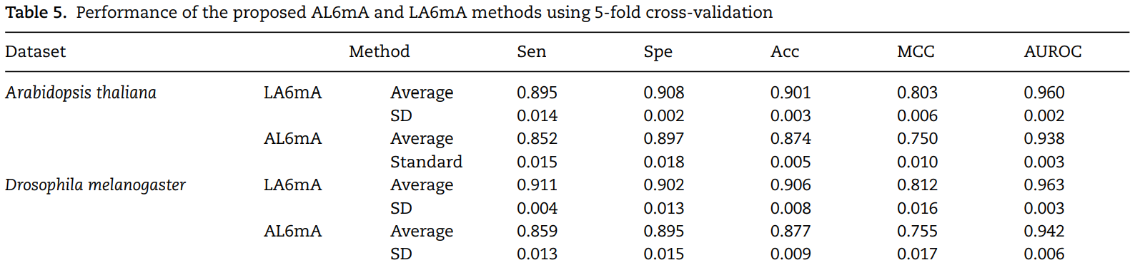
Notes:
他們通過 5-fold cross-validation 評估了所提出模型在 training dataset 上的性能。為了進行公平比較，對於相同生物的，5 個 folds 是固定。表 5 提供了平均性能結果與標準差。可以看出 LA6mA 性能最好。阿拉伯芥的 AUC 為 0.960，其 SD 為 0.002，而果蠅的 AUC 值為 0.963，其 SD 為 0.003。 AL6mA 的性能略低於 LA6mA。 LA6mA 性能測量的 SD 範圍從 0.002 到 0.016，而 AL6mA 的 SD 範圍從 0.003 到 0.018，這反映了提出模型的穩健性。

Slide 40
Performance comparison with the existing methods
The categories of the methods mentioned in the introduction section can be generally categorized into three major groups, i.e. ML-based models, statistical models and DL-based models. To evaluate the performance of our two methods for predicting m6A sites, we further compared them with both DL-based methods and classical k-mer-based logistic regression (LR) method. The compared DL-based methods include DeepM6A [28], i6mADNC [30] and iDNA6mA [26]. All the methods used the same training dataset and test set to make a fair performance comparison. Table 6 summarizes the main characteristics of the compared 6mA site prediction methods, including the features employed, performance evaluation strategy, the corresponding species and the number of samples as well as the availability of code or web server.
Notes:
先前提出的方法通常可以分為三大類，統計model 基於 ML 的model 、和基於 DL 的model 。 為了評估提出預測 m6A site的兩種方法的性能，他們進一步將基於 DL 的方法和基於 k-mer 的 logistic regression方法進行了比較。 比較的DL方法包括 DeepM6A [28]、i6mADNC [30] 和 iDNA6mA [26]。 所有方法都使用相同的training datset和test dataset來進行公平的性能比較。 表 6 總結了比較 6mA site 預測方法的主要特色，包括採用的特徵、評估性能的策略、dataset 的物種和samples數量以及code 或 Web server的可用性。

Slide 41
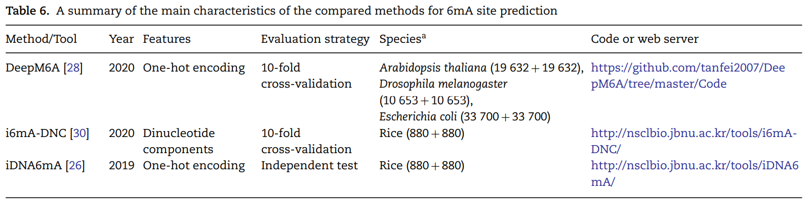
Notes:
先前提出的方法通常可以分為三大類，基於 ML 的模型、統計模型和基於 DL 的模型。 為了評估提出預測 m6A site的兩種方法的性能，他們進一步將基於 DL 的方法和基於 k-mer 的 logistic regression方法進行了比較。 比較的DL方法包括 DeepM6A [28]、i6mADNC [30] 和 iDNA6mA [26]。 所有方法都使用相同的training dataset 和 test dataset來進行公平的性能比較。 表 6 總結了比較 6mA site 預測方法的主要特色，包括採用的特徵、評估性能的策略、dataset 的物種和samples數量以及code 或 Web server的可用性。

Slide 42
Performance comparison with the existing methods
The source code of DeepM6A [28] was downloaded from https://github.com/tanfei2007/DeepM6A/tree/master/Code. To make a fair comparison, we maintained its structure and hyperparameters, adopted the same optimizer with an early stopping strategy and used the final well-trained models for the prediction. The length of the input sequence was adjusted to 41, consistent with the length used in the original DeepM6A work.
For both A. thaliana and D. melanogaster, the models were trained on the training datasets independently without transfer learning. i6mA-DNC [30] and iDNA6mA [26] were reimplemented on the same dataset in this work. The k-mer encoding scheme, a commonly used method of DNA sequence encoding, was used to generate all the possible subsequence frequencies of the input DNA sequences. We set the length of the subsequences as 3, so that each sequence was encoded as a vector of length 64.
Notes:
DeepM6A 的 source code 是從 https://github.com/tanfei2007/DeepM6A/tree/master/Code 下載的。
為了進行公平的比較，他們保留了它的結構和超參數，都用了early stopping 和相同的 optimizer ，並使用最終訓練好的模型進行預測。
輸入序列的長度調整為 41，與原始 DeepM6A 中使用的長度一致。 對於阿拉伯界和果蠅，模型都是在訓練數據集上獨立訓練的，沒有使用 transfer learning。 在這項工作中，i6mA-DNC 和 iDNA6mA 在同一數據集上重新實現。
k-mer(是一種常用的DNA序列編碼方法，用於生成輸入DNA序列的所有可能的子序列)。 他們將子序列的長度設置為 3，以便將每個序列編碼為長度為 64 的向量。

Slide 43
Performance comparison with the existing methods
We used the scikit-learn library to train the LR model (https:// scikit-learn.org/stable/modules/generated/sklearn.linear_mo del.LogisticRegressionCV.html). Five-fold cross-validation was performed to obtain the optimal parameters for the 3-mer-LR method. Table 7 summarizes the performance results of the six different 6mA prediction methods on the two test datasets. In Table 7, the performance values of Sen, Spe, Acc and MCC were calculated based on the prediction cutoff threshold set as 0.5. To facilitate the performance comparison, the values of Sen were calculated by fixing the Specificity. In addition the ROC curves of these methods are displayed in Figure 7.
Notes:
他們使用 scikit-learn 來訓練 LR（https://scikit-learn.org/stable/modules/generated/sklearn.linear_model.LogisticRegressionCV.html）。 進行 Five-fold cross-validation 來獲得 3-mer-LR 方法的最佳參數。 表 7 總結了六種不同的 6mA 預測方法在兩個 test dataset 上的性能結果。

Slide 44
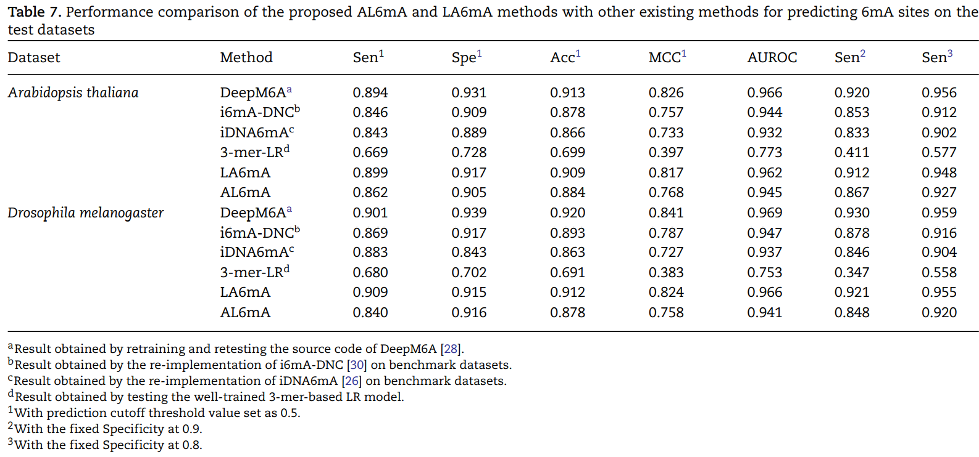
Notes:
可以看出，DeepM6A 在 6mA 預測中的表現最佳，在阿拉伯芥上的 AUROC = 0.966 和在果蠅上的 AUROC = 0.969 分別高於所有其他比較方法。基於傳統機器學習開發的 3-mer-LR 方法在所有性能指標都是最低的。 對於阿拉伯芥中的 6mA 預測，我們提出的 LA6mA 方法的 AUC 為 0.962，略低於 DeepM6A 的 AUC 0.966 。 而對於果蠅中的 6mA 預測，其他三種基於 DL 的方法，包括 i6mA-DNC、AL6mA 和 iDNA6mA 性能均非常相似，AUC 值範圍為 0.937 到 0.947（表 7）。

Slide 45
Performance comparison with the existing methods
As can be seen, DeepM6A achieved the overall best performance for 6mA prediction with AUROC = 0.966 on A. thaliana and AUROC = 0.969 on D. melanogaster, respectively, both of which were higher than all the other compared methods. Not surprisingly, the 3-mer-LR method, which was developed based on conventional machine learning, achieved the lowest predictive performance in terms of all performance metrics.
For 6mA prediction in A. thaliana, our proposed LA6mA method achieved an AUROC value of 0.962, which was the 2nd-best performance and slightly lower than that of DeepM6A, which achieved an AUROC of 0.966. While for 6mA prediction in D. melanogaster, the other three DL-based methods, including i6mA-DNC, AL6mA and iDNA6mA achieved a very similar performance with AUROC values ranging from 0.937 to 0.947 (Table 7).
Notes:
可以看出，DeepM6A 在 6mA 預測中的表現最佳，在阿拉伯芥上的 AUROC = 0.966 和在果蠅上的 AUROC = 0.969 分別高於所有其他比較方法。基於傳統機器學習開發的 3-mer-LR 方法在所有性能指標都是最低的。 對於阿拉伯芥中的 6mA 預測，我們提出的 LA6mA 方法的 AUC 為 0.962，略低於 DeepM6A 的 AUC 0.966 。 而對於果蠅中的 6mA 預測，其他三種基於 DL 的方法，包括 i6mA-DNC、AL6mA 和 iDNA6mA 性能均非常相似，AUC 值範圍為 0.937 到 0.947（表 7）。

Slide 46
Performance comparison with the existing methods
True positive rate is also named as Sen, and the sum of false positive rate (FPR) and Spe is 1, which means FPR = 1−Spe. In addition, Table 7 also provides performance comparison of different methods in terms of Sen under the fixed Specificity (i.e. 0.8 and 0.9). For both model organisms, it can be concluded that DeepM6A consistently performed best under fixed Specificity, followed by LA6mA. As shown in Figure 7, for A. thaliana, the Sen of AL6mA and i6mA-DNC reached the same value under the fixed Specificity of 0.93. The Sen of AL6mA achieved a larger value when the Specificity was smaller than 0.93; however, the situation was the opposite when the Specificity was larger than 0.93. In contrast, for D. melanogaster in Figure 7B, the threshold of the Specificity between AL6mA and i6mADNC was 0.82.
It is worth mentioning that DeepM6A is a deep convolutional network with 315 481 parameters, whereas the proposed AL6mA and LA6mA only have 138 043 (43.76% of DeepM6A) and 159 235 (50.47% of DeepM6A) parameters, respectively. This suggests that LA6mA could achieve a competitive performance with that of DeepM6A by using only half of its parameters.
Notes:
真陽性率也稱為Sen，假陽性率（FPR）與Spe之和為1，即FPR = 1−Spe。此外，表 7 還提供了在固定Specificity（即 0.8 和 0.9）下不同方法在 Sen 方面的性能比較。這兩種生物，可以得出結論，DeepM6A 在固定 Specificity 下表現都是最好的，其次是 LA6mA。如圖 7 所示，在阿拉伯芥 dataset ，在 0.93 的固定 Specificity 下，AL6mA 和 i6mA-DNC 的 Sensitivity 的值會相同。 AL6mA 的 Sen 在 Specificity 小於0.93時會比i6mA-DNC大，當Specificity大於0.93時，情況正好相反，sen 會比i6mA-DNC小。相比之下，對於圖 7B 中的果蠅，AL6mA 和 i6mADNC 之間的Specificity threshold 為 0.82。
值得一提的是，DeepM6A 是一個deep convolutional network ，有 315 481 個參數，而提出的 AL6mA 和 LA6mA 分別只有 138 043 個（DeepM6A 的 43.76%）和 159 235 個（DeepM6A 的 50.47%）參數。這表明 LA6mA 只需使用其一半的參數即可實現與 DeepM6A 差不多的性能。

Slide 47
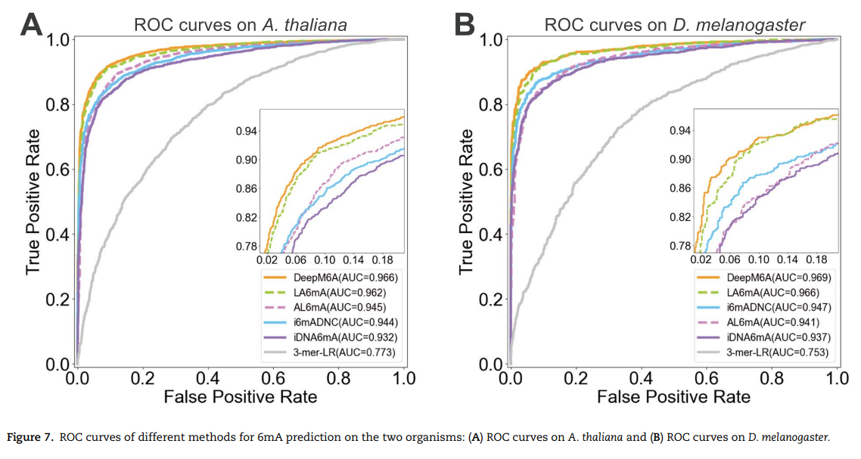
Notes:
真陽性率也稱為Sen，假陽性率（FPR）與Spe之和為1，即FPR = 1−Spe。此外，表 7 還提供了在固定Specificity（即 0.8 和 0.9）下不同方法在 Sen 方面的性能比較。這兩種生物，可以得出結論，DeepM6A 在固定 Specificity 下表現都是最好的，其次是 LA6mA。如圖 7 所示，在阿拉伯芥 dataset ，在 0.93 的固定 Specificity 下，AL6mA 和 i6mA-DNC 的 Sensitivity 的值會相同。 AL6mA 的 Sen 在 Specificity 小於0.93時會比i6mA-DNC大，當Specificity大於0.93時，情況正好相反，sen 會比i6mA-DNC小。相比之下，對於圖 7B 中的果蠅，AL6mA 和 i6mADNC 之間的Specificity threshold 為 0.82。
值得一提的是，DeepM6A 是一個deep convolutional network ，有 315 481 個參數，而提出的 AL6mA 和 LA6mA 分別只有 138 043 個（DeepM6A 的 43.76%）和 159 235 個（DeepM6A 的 50.47%）參數。這表明 LA6mA 只需使用其一半的參數即可實現與 DeepM6A 差不多的性能。

Slide 48
Conclusions
DL can automatically extract useful features from raw genome sequence data that are pertinent to the prediction task. Nevertheless, such capability can be a ‘double-edged sword’: on one hand, researchers are liberated from the complicated, tedious and manual feature extraction process, but on the other hand, researchers find it challenging to address the ‘blackbox’ issue and interpret the models. In this study, we have proposed two novel computational methods for DNA 6mA site identification, which are termed LA6mA and AL6mA, respectively. The networks of these two methods mainly consist of the LSTM layer and attention layer.
The LSTM layer can automatically capture the short-range and long-range information from the encoded input sequences, whereas the attention layer provides biologically meaningful interpretations through introducing sequence context information and identifying the key positions surrounding the potential 6mA/non-6maA sites that contribute the most to the final prediction. Specifically, the attention layer after the LSTM layer is responsible for processing the extracted features and generating the abstract attentions to find the key areas of universality between the organisms (e.g. A. thaliana and D. melanogaster), whereas the attention layer preceding the LSTM layer pays attention to the individuality between organisms. Benchmarking experiments have demonstrated that the two methods could achieve a competitive performance for DNA 6mA site prediction.
Notes:
DL 可以自動從原始序列數據中提取有用的特徵。 這種能力有好處也有壞處：一方面，研究人員不用自己設計 feature，但另一方面，研究人員需要從黑盒子解釋模型。 在這項研究中，他們提出了兩種新的 DNA 6mA 位點識別計算方法，分別稱為 LA6mA 和 AL6mA。 這兩種方法的網絡主要由 LSTM 層attention layer組成。
LSTM 層可以從編碼過的輸入序列中自動捕獲短程和遠程信息，而attention layer 識別潛在的 6mA/非 6maA site 周圍的關鍵位置來提供具有生物學意義的解釋。 具體來說，LSTM 之後的 attention layer 負責處理提取的特徵並生成抽象的 attention 以找到生物體（例如阿拉伯芥和果蠅）之間普遍的關鍵區域，而 LSTM 層之前的attention layer 關註生物之間的個別位置訊息。 這兩種方法可以在 DNA 6mA site 預測方面取得有競爭力的性能。

Slide 49
Conclusions
In future work, a potentially useful strategy based on the multi-head attention mechanism [51] can be employed, which has been successfully applied to address protein classification and generation tasks [52]. Analogous to the simultaneous use of multiple filters in CNNs, the multi-head attention allows the model to capture information from different representation subspaces, which might be helpful for extracting richer information from the input sequences.
Interpreting the attention mechanism with complex RNN network architectures or the attention mechanism with RNN and CNN can be also investigated. The two proposed methods herein are promising and are generally applicable to address other sequence-based problems in the fields of bioinformatics and computational biology.
Notes:
在未來，可以利用multi-head attention，這個方法已成功應用於解決蛋白質分類和生成任務 [52]。 類似於在 CNN 中同時使用多個過濾器，multi-head attention 允許模型從不同的子空間中捕獲訊息，這可能有助於從輸入序列中提取更豐富的信息。
還可以研究解釋具有復雜 RNN 網絡架構的 attention 或具有 RNN 和 CNN 的attention 。

